Slide 2
David Hackney
Project Coordinator
West Midlands

Slide 4
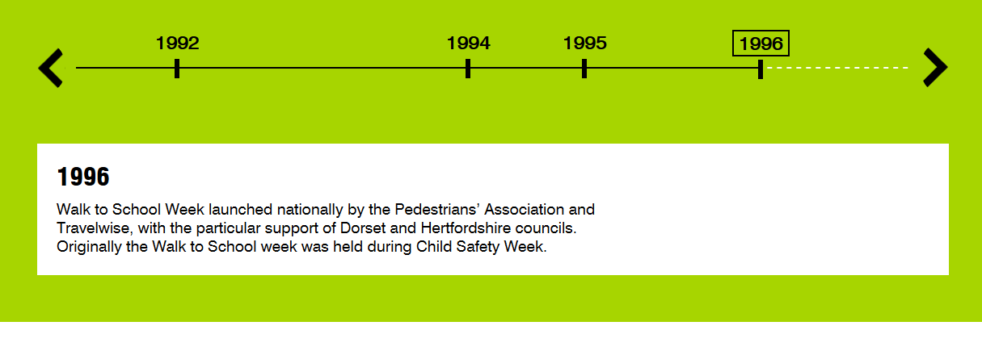
WALK TO school project

Slide 5
Notes:
Hi everyone.
Today I’m going to be talking to you about WOW, the year-round walk to school challenge, part of Living Street’s Walk to School campaign that your/our school is taking part in. You can earn badges, just for walking to school.

Slide 6
Notes:
You can also earn a WOW badge if you scoot or cycle to school at least once a week.
And if you live too far from the school to walk all the way from home than you can earn a WOW badge by combining a walk with a bus or car journey. If you come to school by bus then you could “Hop Off” the bus a stop or two early and finish your journey on foot. And if you need to come by car, we’d like you and your families to Park and Stride. This is where you park your car a 10 minute walk away from the school gates.

Slide 8
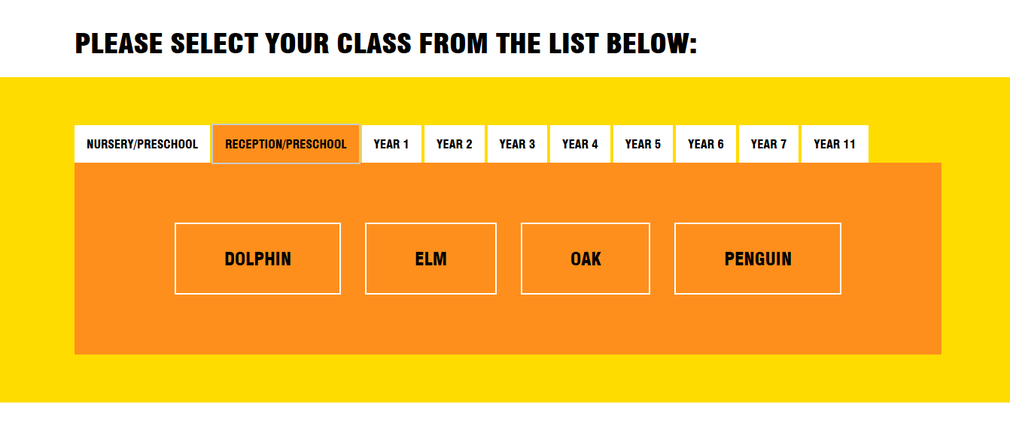

Slide 9
Notes:
We will be using a special tool in class to record everyone’s journeys – the Travel Tracker.
Your class will have a screen like this - everyone in the class will have a different icon – make sure you remember yours.
Everyone records how they got to school every day, so we know who walks, cycles, scoots or Park and Strides to earn a WOW badge.
All the different ways to get to school are recorded, including car, train and bus [add any other modes that may be popular at school]…
[Joke] For anyone who comes by helicopter, hovercraft or special jet-pack - that all goes under ‘Other’.
So, you just need to:
1. Click on your icon (which will be assigned to you by your teacher)
2. Click on how you got to school
3. Click on OK
NOTE FOR TEACHERS – you can see who still has to record a mode of travel as they will not have a circle around their name.
OPTIONAL: Some of you might be asked to be a WOW monitor. This is a very important job which involves helping your classmates record their travel each day and awarding badges at the end of each month.

Slide 10
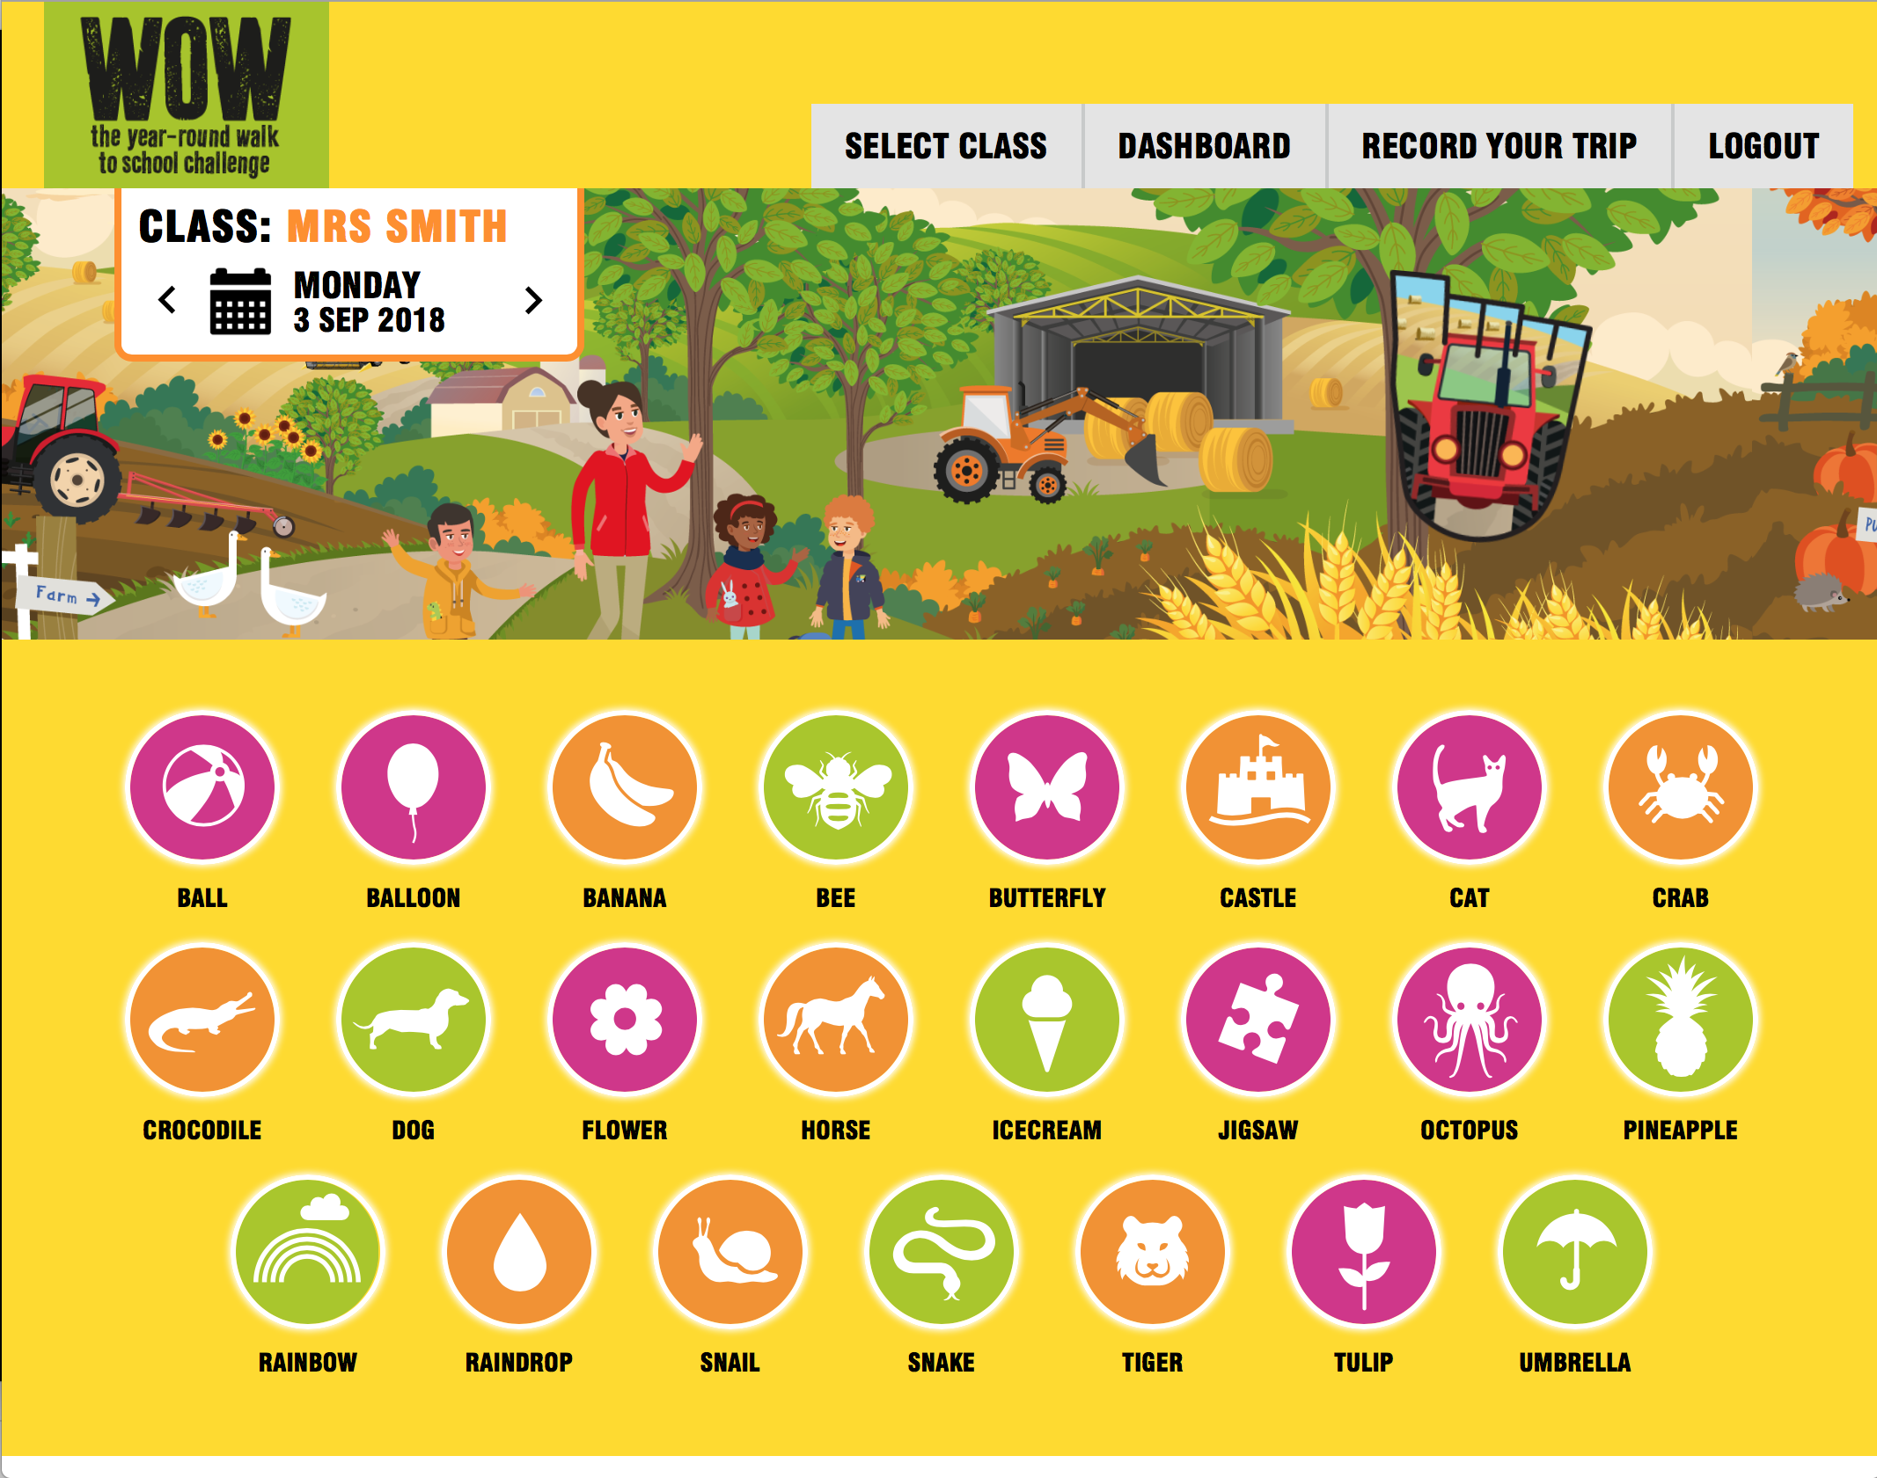
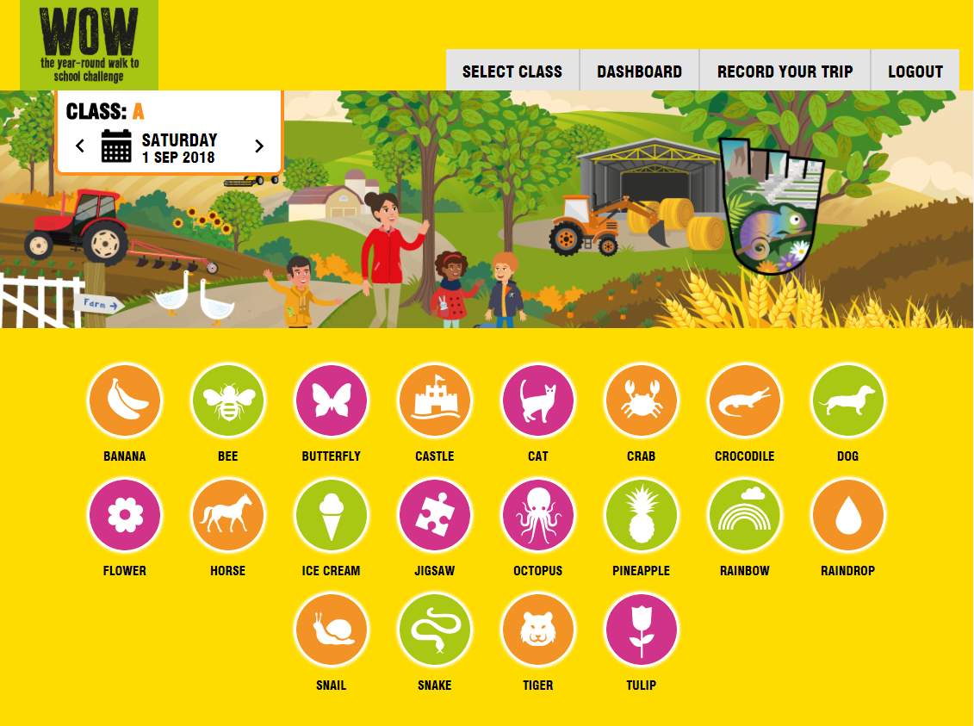
Notes:
We will be using a special tool in class to record everyone’s journeys – the Travel Tracker.
Your class will have a screen like this - everyone in the class will have a different icon – make sure you remember yours.
Everyone records how they got to school every day, so we know who walks, cycles, scoots or Park and Strides to earn a WOW badge.
All the different ways to get to school are recorded, including car, train and bus [add any other modes that may be popular at school]…
[Joke] For anyone who comes by helicopter, hovercraft or special jet-pack - that all goes under ‘Other’.
So, you just need to:
1. Click on your icon (which will be assigned to you by your teacher)
2. Click on how you got to school
3. Click on OK
NOTE FOR TEACHERS – you can see who still has to record a mode of travel as they will not have a circle around their name.
OPTIONAL: Some of you might be asked to be a WOW monitor. This is a very important job which involves helping your classmates record their travel each day and awarding badges at the end of each month.

Slide 12
WOW Local Impact
In 2017/18 Living Streets' Walk to School campaign supported approximately 970,000 children in 3,100 primary schools.

Slide 13
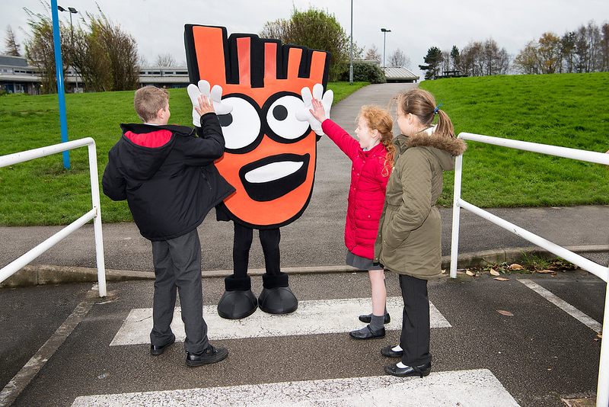
WOW gets 23% more children walking some or all of the way to school after five weeks, and results in 30% fewer all-the-way car journeys.
Notes:
From hands-up survey data compared to baseline collected before WoW delivery started. Includes Walking all the Way, Park & Stride, and Scooting / Skating.

Slide 14
Notes:
In the school year 2017/18, Walk To supported 180,000 children in 677 primary schools. For the schools using Travel Tracker, and properly tagged as Walk To, the data shows 84% of journeys to school were walked all or part of the way, a 29% increase on the baseline walking rate of 65%.
Walk To Y1 TT data and analysis. Note this includes some 2016/17 data as well.

Slide 15
Notes:
Why is it good to walk to school? Hands up if you can think of reasons.
[Take some answers]
That’s brilliant. You’ve come up with some great suggestions.

Slide 16
Notes:
Walking is good exercise for us. As we walk our hearts beat faster, our breathing gets quicker, we warm up, and we feel energised. Exercise is important because it helps to keep our bodies healthy and is good for our hearts, lungs, muscles and bones.
Did you know that it’s recommended that you carry out 60 minutes of physical activity every day?
Well, the walk to school is a really good way of getting some of that exercise. And not only does walking help keep us fit and healthy, it can help wake us up in the morning and make us feel happy! If you walk to school then you’ll be more alert when you come into the classroom, and a lot more relaxed and ready to start your day.

Slide 17
Notes:
Imagine if everybody walked to school, there would be fewer cars outside the school gates. This would make it safer for families walking to school.

Slide 18
Notes:
Walking is the greenest form of transport so you can actually help the planet too by walking.
There are over 10 million children travelling to school every morning in the UK and nearly half of children travelling to school make that journey in a car.
Why is it better for the environment if we walk rather than travel by car?
Do you think it’s better for you too if less cars on the roads? Why?
Yes, it is better for you to walk – you actually breathe in less air pollution than if you’re sitting in a car!
Hands up if you have any ideas.
(Take a few suggestions, answers along the lines of: cars release gases that pollute the air and this contributes to global warming, whereas walking is clean and green)
Hands down.
If more people walked there would be fewer people in their cars and less pollution would be pumped into the air.

Slide 19
Notes:
Walking to school is also fun! And it’s a great time for talking too!
Walking to school is a great time to talk to your family and they can find out about your day. Because when your parents/carers drive you, they will have to focus on the road more so probably won’t be able to talk as much.
You could meet up with your friends on your way to and from school too – a great time for talking to them! Hands up if you met your friends on the way into school this morning? Great, hands down.

Slide 20
Notes:
Can anyone guess what Strider is? (ask for a couple of suggestions) He’s a big pair of feet!
He’s been walking to school for 20 years. He’ll be with you every step of the way as we walk to school across the year.
Look out for him along the way, as he’ll have some tips to keep you walking each month

